Slide 1


Presentation on Historica AR/VR Powered Immersive Historical Learning Experience
Guided By: Presented By:
Prof. Monika Choudhary Atharv Sharma (0827IT233D02)
Khushi Agrawal (0827IT221076)
Abhishek Rathore (0827IT233D01)
Jatin Rao (0827IT233D03)

Slide 2
Contents
1. Methodology
1.1 Proposed Algorithm
2. Implementation Approach
2.1 Introduction to Languages, IDEs Tools and Technologies
3. Testing Approaches
3.1 Unit Testing
a. Test Cases
3.2 Integration Testing
b. Test Cases

Slide 3
Contents (Continued)
4. Results & Discussion
4.1 User Interface Representation
4.1.1 Brief Description of Various Modules
4.2 Snapshot of System with Brief Description
4.3 Database Description
4.3.1 Snapshot of Database Tables with Brief Description
4.4 Final Findings
5. Conclusion & Future Scope
5.1 Conclusion
5.2 Future Scope

Slide 4
1. Methodology 1.1 Proposed Algorithm
1. Requirement Analysis
Conducted research to identify gaps in traditional history education and current AR/VR solutions.
Defined key user needs: accessibility, interactivity, historical accuracy, and immersive visualization.
Finalized project scope to include interactive 3D AR models, historical simulations, and AI-based reconstructions.
2. System Design
Architecture Design:
Client-server model with a decoupled frontend (React + Three.js) and backend (Node.js/Express).
Component Design:
Modular components for map interface, time travel scenes, 3D avatars, and AI interactions.
Integration of AR views through browser-based 3D rendering engines using WebGL.
3. Front-End Implementation
Developed a dynamic interface using React 18 with TypeScript for robustness and scalability.
Integrated Leaflet.js for map-based historical exploration.
Utilized React Three Fiber and Three.js to render interactive 3D historical environments.
Added Framer Motion and Radix UI for animations and UI elements to enhance user experience.

Slide 5
1. Methodology 1.1 Proposed Algorithm
4. Back-End Development
Built RESTful APIs using Express.js with TypeScript for secure and scalable data operations.
Implemented session management for user authentication and personalization.
5. AI Integration
Leveraged Generative AI to recreate historical scenes, events, and characters using pre-trained models.
Enabled AI-driven interactions with historical avatars using NLP models to simulate conversations and storytelling.
Designed a “Quantum History Mode” to simulate alternative timelines and "What If" scenarios.
6. 3D Asset & Scene Development
Generated 3D models of landmarks and ancient environments based on historical data.
Incorporated AI-based reconstruction techniques to restore lost or destroyed structures visually.
Ensured models are lightweight and optimized for web performance.
6. 3D Asset & Scene Development
Generated 3D models of landmarks and ancient environments based on historical data.
Incorporated AI-based reconstruction techniques to restore lost or destroyed structures visually.
Ensured models are lightweight and optimized for web performance.

Slide 6
2. Implementation Approach 2.1 Introduction to Languages, IDEs Tools and Technologies
Languages Used:
TypeScript: Used extensively on both the front-end (React) and backend (Node.js/Express) for type-safe development, reducing runtime errors and improving maintainability.
JavaScript: Utilized within libraries like Three.js and Leaflet for dynamic interactions and 3D rendering.
HTML/CSS: For structure and base styling, with modern enhancements using TailwindCSS and PostCSS.
IDEs and Development Environments:
Visual Studio Code (VS Code): The primary development environment used for writing, debugging, and managing TypeScript, JavaScript, and styling files. VS Code’s extensions support efficient web development workflows.
Chrome DevTools: For in-browser testing, responsive design checking, and performance optimization.
Development Tools and Utilities:
TypeScript: Brings static typing to JavaScript, allowing safer code and better IDE support.
TSX: Allows direct execution of TypeScript files during development for quick prototyping.
PostCSS: Processes CSS with plugins for better performance and enhanced compatibility.

Slide 7
3. Testing Approaches 3.1 Unit Testing a. Test Cases
Test Case | Objective | Expected Outcome
Render Time Travel Scene | Test if 3D scene renders based on selected event | Correct 3D scene is displayed
Click Map Marker | Verify marker interaction and data fetch | Popup shows accurate historical info
AI Avatar Interaction | Test AI chat response to user input | Avatar replies with relevant historical details
Page Navigation | Ensure correct routing between pages | Target page loads and URL updates
Fetch Historical Data (API) | Test API call and data rendering | Data is displayed without error
Update Global State | Check state changes via user interaction | UI updates with new time/location
User Login | Validate session creation after login | Session is established and retained
Load 3D Asset | Confirm model loads properly | 3D asset appears within acceptable time
Trigger Entry Animation | Test animation on new scene load | Animation plays as expected
Display Learning Path | Test personalized content rendering | AI-based suggestions appear based on user history

Slide 8
3.2 Integration Testing b. Test Cases
Test Case | Objective | Expected Outcome
Map to Scene Integration | Verify that selecting a map marker loads the correct 3D scene | Corresponding historical scene is rendered on selection
User Login to Personalized Dashboard | Test login flow and personalized content rendering | User is logged in and sees tailored learning paths
AI Avatar with Scene Context | Test AI avatar response based on current 3D environment | Avatar gives scene-specific historical insights
API + 3D Model Load | Verify data fetch and model rendering together | Scene loads with accurate data and 3D visuals
Session Persistence + Routing | Test session retention during navigation | User remains logged in across different pages
Time Travel Selection + Animation Trigger | Check interaction of time period selection and animation | Scene changes and animation plays seamlessly
Scene Interaction + State Update | Test object interaction and UI state update | Info panel or avatar updates as user interacts
Avatar Chat + Data Store Update | Validate AI interaction modifies or logs user progress | User’s historical journey is updated based on conversation
Map Load + Performance Metrics | Test map component with live data and rendering performance | Map loads accurately without lag
Backend Sync with Frontend Preferences | Verify backend settings affect frontend UI (e.g., dark mode) | User preferences apply across frontend after backend fetch

Slide 9
4. Results & Discussion 4.1 User Interface Representation 4.1.1 Brief Description of Various Modules
Module Name | Brief Description
User Authentication Module | Manages user login, registration, and session handling.
Interactive Map Module | Displays global landmarks and links them to historical scenes.
Time Travel & Scene Renderer Module | Renders 3D historical environments based on selected era and location.
AI Avatar Interaction Module | Allows users to chat with AI-powered historical characters.
Historical Content & Data Module | Provides facts, timelines, and descriptions from the database.
3D Asset Management Module | Loads and optimizes 3D models for immersive viewing.
Personalized Learning Path Module | Suggests tailored historical content based on user activity.
Quantum History Mode Module | Simulates alternate historical scenarios using AI.
UI/UX and Animation Module | Enhances user experience with transitions and visual effects.

Slide 10
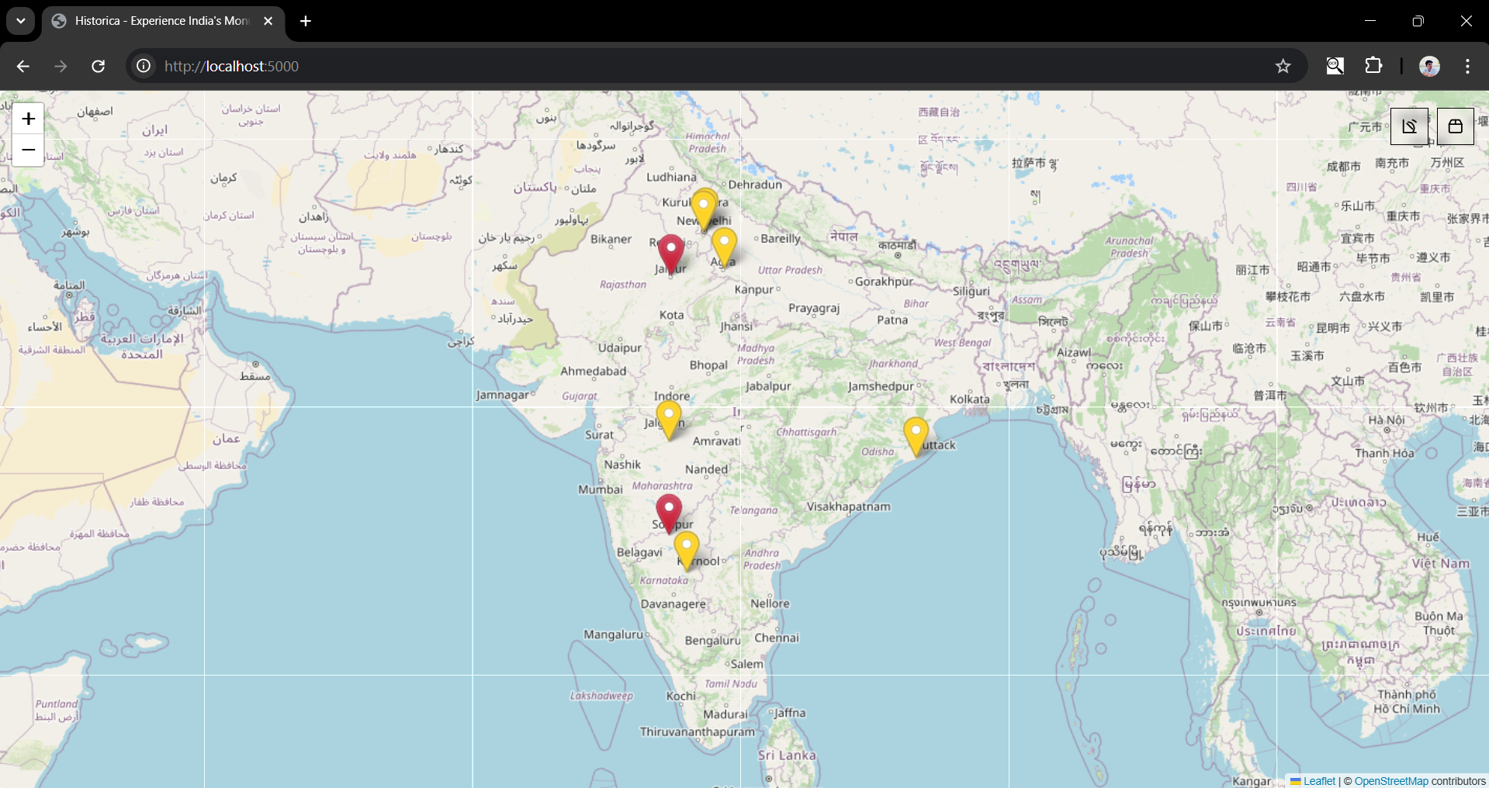
4.2 Snapshot of System with Brief Description
The image shows an interactive Leaflet-based map interface highlighting monuments across India with colored location markers.

Slide 11
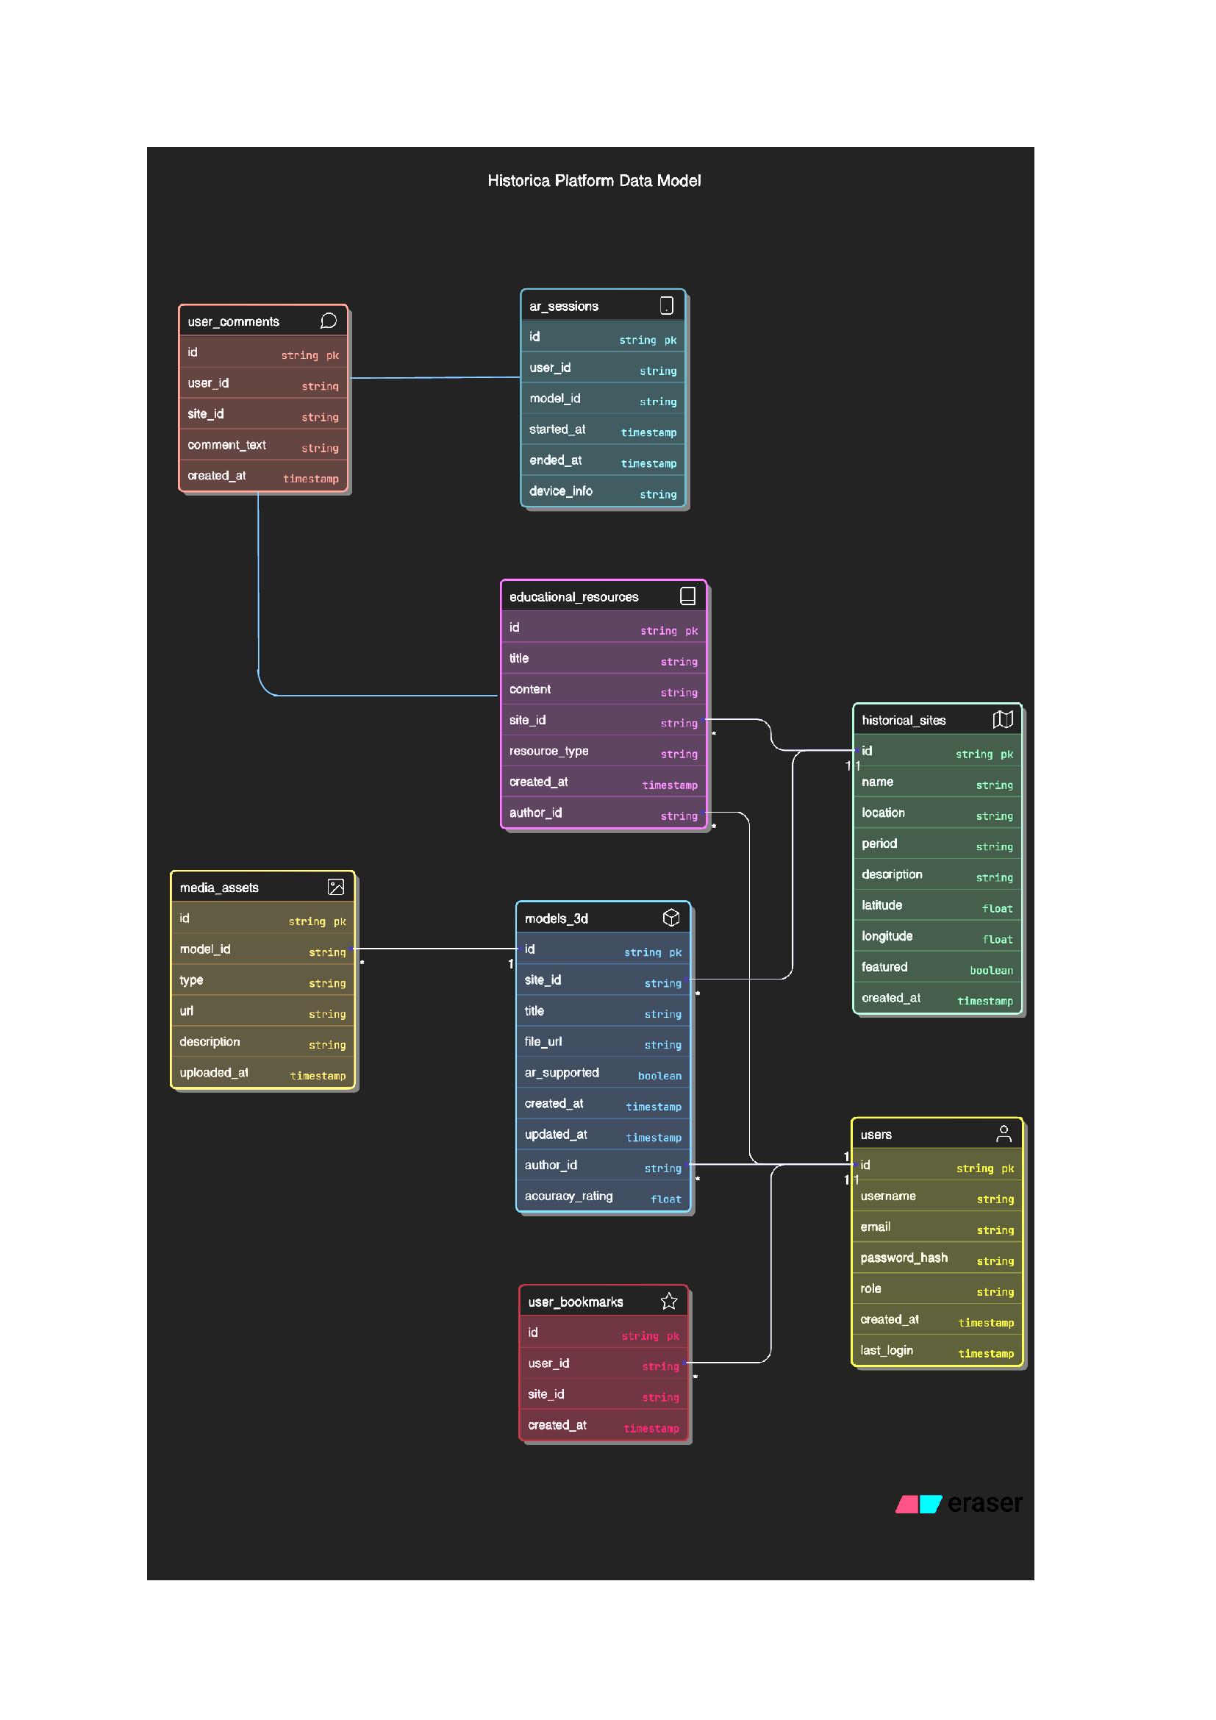
4.3 Database Description 4.3.1 Snapshot of Database Tables with Brief Description

Slide 12
4.4 Final Findings
Finding | Description
Enhanced Historical Engagement | Provided immersive AR-based learning with interactive 3D scenes and AI avatars.
Seamless Web-Based Access | Enabled users to explore historical content via browser without needing extra hardware.
Effective Use of Modern Tech Stack | Utilized React, Three.js, Leaflet, and Express for a smooth, high-performance experience.
AI Personalization & Simulation | Offered personalized learning paths and “What-if” scenarios using AI capabilities.
Interactive Map Navigation | Allowed intuitive exploration of historical landmarks through a dynamic map interface.
Educational and Cultural Impact | Promoted historical awareness and preserved cultural heritage digitally.
Scalable and Extensible Architecture | Designed for easy addition of new content, regions, and advanced features in the future.

Slide 13
5. Conclusion & Future Scope 5.1 Conclusion
The Historica project successfully demonstrates how immersive technologies like Augmented Reality, 3D modeling, and AI can revolutionize the way history is explored and understood. By transforming static historical facts into interactive experiences, Historica makes learning more engaging, accessible, and memorable. With its browser-based interface, users can time travel to ancient eras, interact with historical avatars, and explore culturally significant landmarks without the need for specialized hardware.
The potential of Historica extends far beyond its current implementation. In the future, the platform can integrate support for Virtual Reality (VR) headsets, voice-based AI avatars, multilingual content, real-time collaborative exploration, and integration with educational curricula. It also holds promise for global expansion, enabling the inclusion of world heritage sites and localized cultural stories.
5.2 Future Scope

